Slide 1
BA MM Team
Change Control Process

Slide 2
Agenda
Purpose / Guidelines
Members
Change Request Form
Change Request Log
Change Request Process

Slide 3
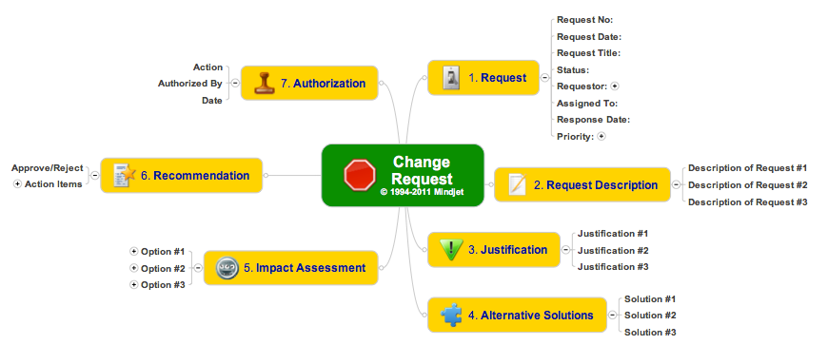
Scope for Change Control

Slide 4
Purpose
The BA MM is a federated composite of packages that can be individually updated by members of the BA MM Team.
In order to control the review process and impacts from any one update, we need to establish a process for the packages and for the 3 layers that comprise the MM.
Changes need to be rolled out in a progressive manner to ensure integrity for the BA MM and all related artifacts.

Slide 5
Guidelines
Changes to any package can be undertaken by a member of the BA MM team.
Each package will be separately incremented using version control.
The Core Team will determine numbering conventions for each release.
Updates for the Glossary, Relationships, MM will need to be cross referenced using an XLS.
Updates to the BIZBOK (esp. with section 5.1 and related Appendices) will map to the XLS.

Slide 6
Change Control Log
As referenced in the prior slide, an XLS will be maintained by the lead / backup editors for the BA MM.
This must be kept current with each release.
A separate library of artifacts will be maintained for each BA MM release on the Guild Website (in the BA MM team directory).
Interim deliverables should be posted to Slack (for now) to preserve tracking and minimize exposure to loss.

Slide 7
BA MM Team RACI
Role | Team Member | R | A | C | I
Team Lead | Jeff |  | X
BA MM Editor (primary) | Lloyd / Jim | X | X
Change Control Log | Lloyd / Jim | X | X
Relationship Matrix | Chalon | X | X
Package Editors | Rest of Team | X
Package Editors | Vendor Reps |  |  | X
Release Manager | Lloyd / Jim | X | X
Publishing (BIZBOK) | Jeff | X | X
Publishing White Papers | Rest of Team | X
Publishing White Papers | Vendor Reps |  |  | X

